Slide 1
Resource Design Tool: Installation

Slide 2
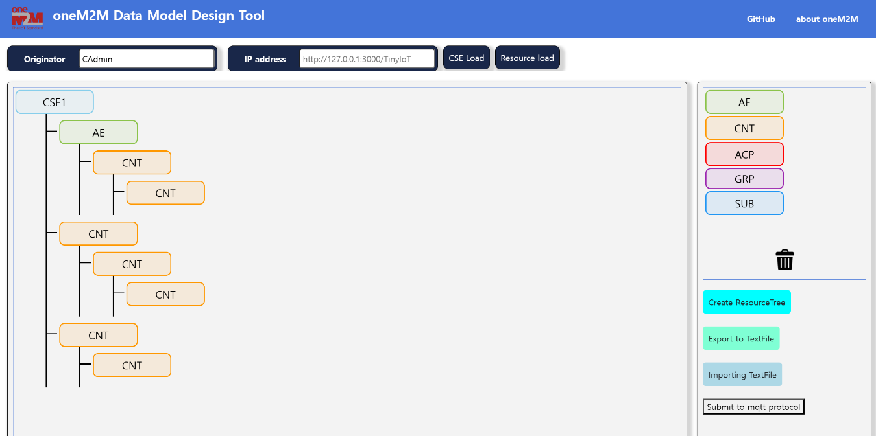
Resource Design Tool Overview
Design tool is designed to help you design oneM2M data model.
It is based on the oneM2M data standards described in TS-0001. and the tool is written in Vue3
Available functions
CSE Load
Drag & Drop
Create resources
Resource load
Prerequisities
OS (Windows or Ubuntu)
Node.js (Version v20.10.0 or lower required)

Slide 3
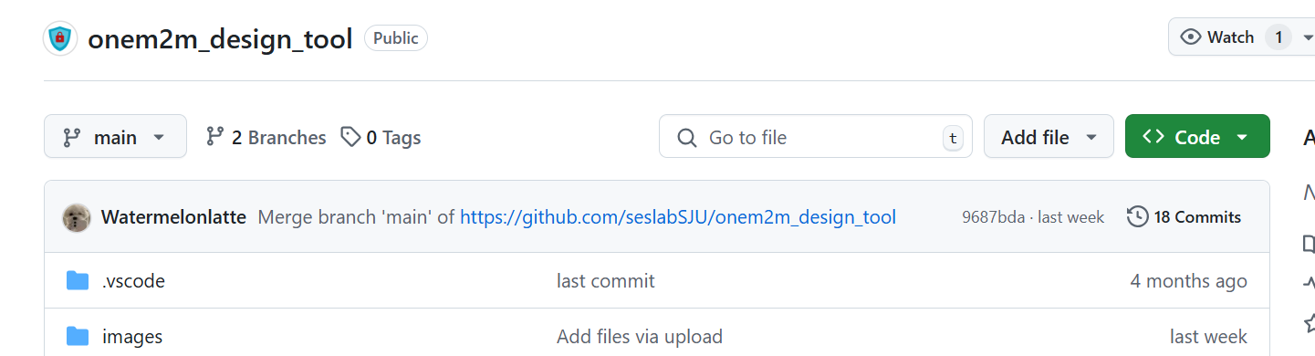
Resource Design Tool Installation
Clone resource design tool repository
https://github.com/seslabSJU/onem2m_design_tool
$ git clone https://github.com/seslabSJU/onem2m_design_tool

Slide 4
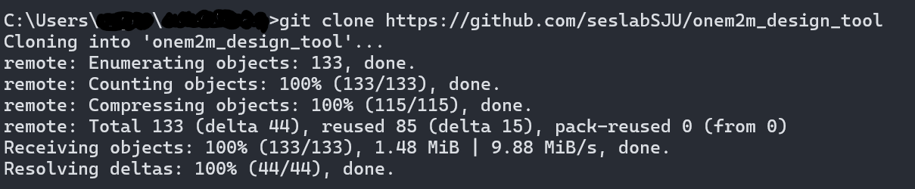
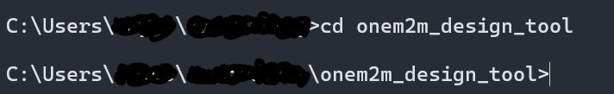
Resource Design Tool Installation
Move to onem2m_design_tool directory
$ cd onem2m_design_tool

Slide 5
Environment Setting
Check the version of Node.js
$ node -v (Version v20.10.0 or lower is required, v20.10.0 recommended)
If Node.js is not installed, download and install it from the link below
https://nodejs.org/download/release/v20.10.0/
if the Node.js version is not available, (Node.js & npm are already installed)
Install NVM for Node.js version management.
https://github.com/coreybutler/nvm-windows/

Slide 6
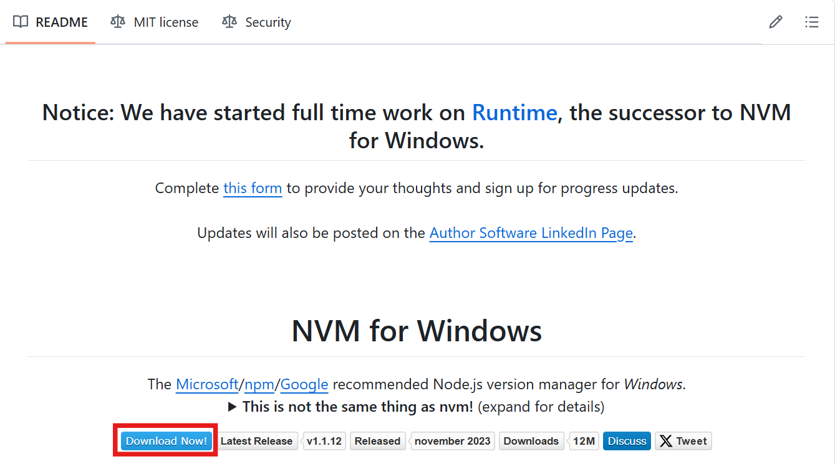
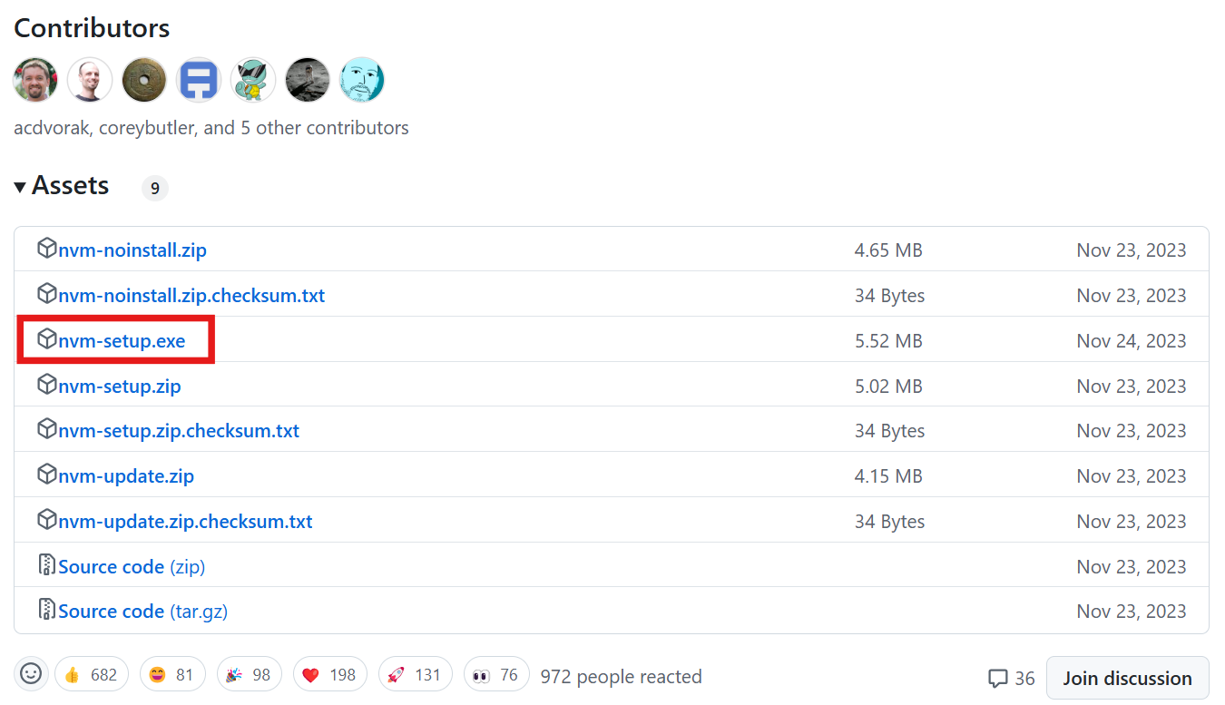
Environment Setting
Install the NVM

Slide 7
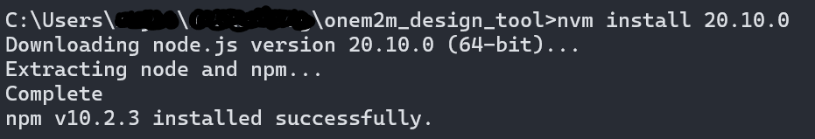
Environment Setting
Check NVM Installation and Available Node.js Versions
$ nvm –v
$ nvm list available
Install the Required Node.js Version
$nvm install 20.10.0

Slide 8
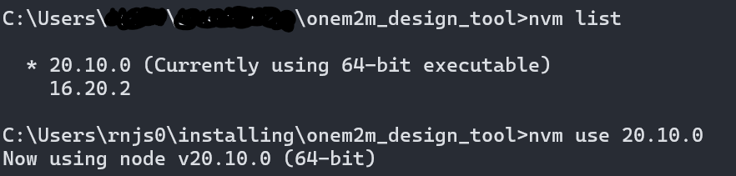
Environment Setting
Change the Node.js Version
$ nvm list
$ nvm use 20.10.0
Checking the Node.js Version
$ node –v

Slide 9
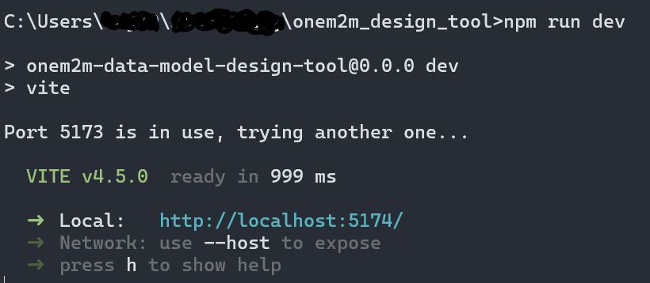
Resource Design Tool Installation
Install requirements
$ npm install
$ npm run dev
Enter the address that appears afterward

Slide 10
How to Use the Resource Design Tool

Slide 11
Key Features of the Tool
CSE Load
Connect to an external CSE server to load and visualize its resource tree for further modeling.
Drag & Drop
Intuitively model resources using a drag-and-drop interface
Drag components into the canvas to design resource structures.
Create Resources
Easily create resources or resource trees with a few clicks.
Modify resource attributes and relationships in the modal.
Resource Load
Retrieve and manage existing resources effortlessly.
Save the resource tree or load existing resources from a server.

Slide 12
CSE Load
This feature connects to an external oneM2M-compatible CSE server, allowing you to load and visualize its complete resource tree for further modeling or management.
How to use
Enter the URL or IP address of the target CSE server.
Click the CSE Load button in the toolbar.
View the loaded CSE resources.

Slide 13
Drag & Drop
Drag & Drop allows you to visually organize and design the hierarchy of oneM2M resources within the modeling tool. This intuitive interface helps you build resource trees efficiently.
How to use
Open the modeling tool interface.
Select a resource type (e.g., AE, CNT) from the left panel.
Drag the resource to the canvas and place it in the desired position.
Adjust the resources as needed to create the structure.

Slide 14
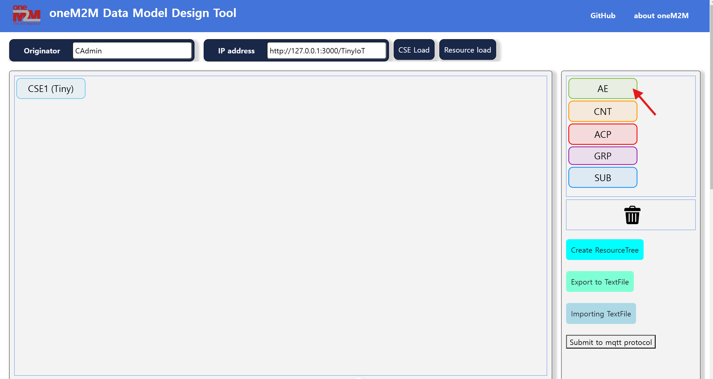
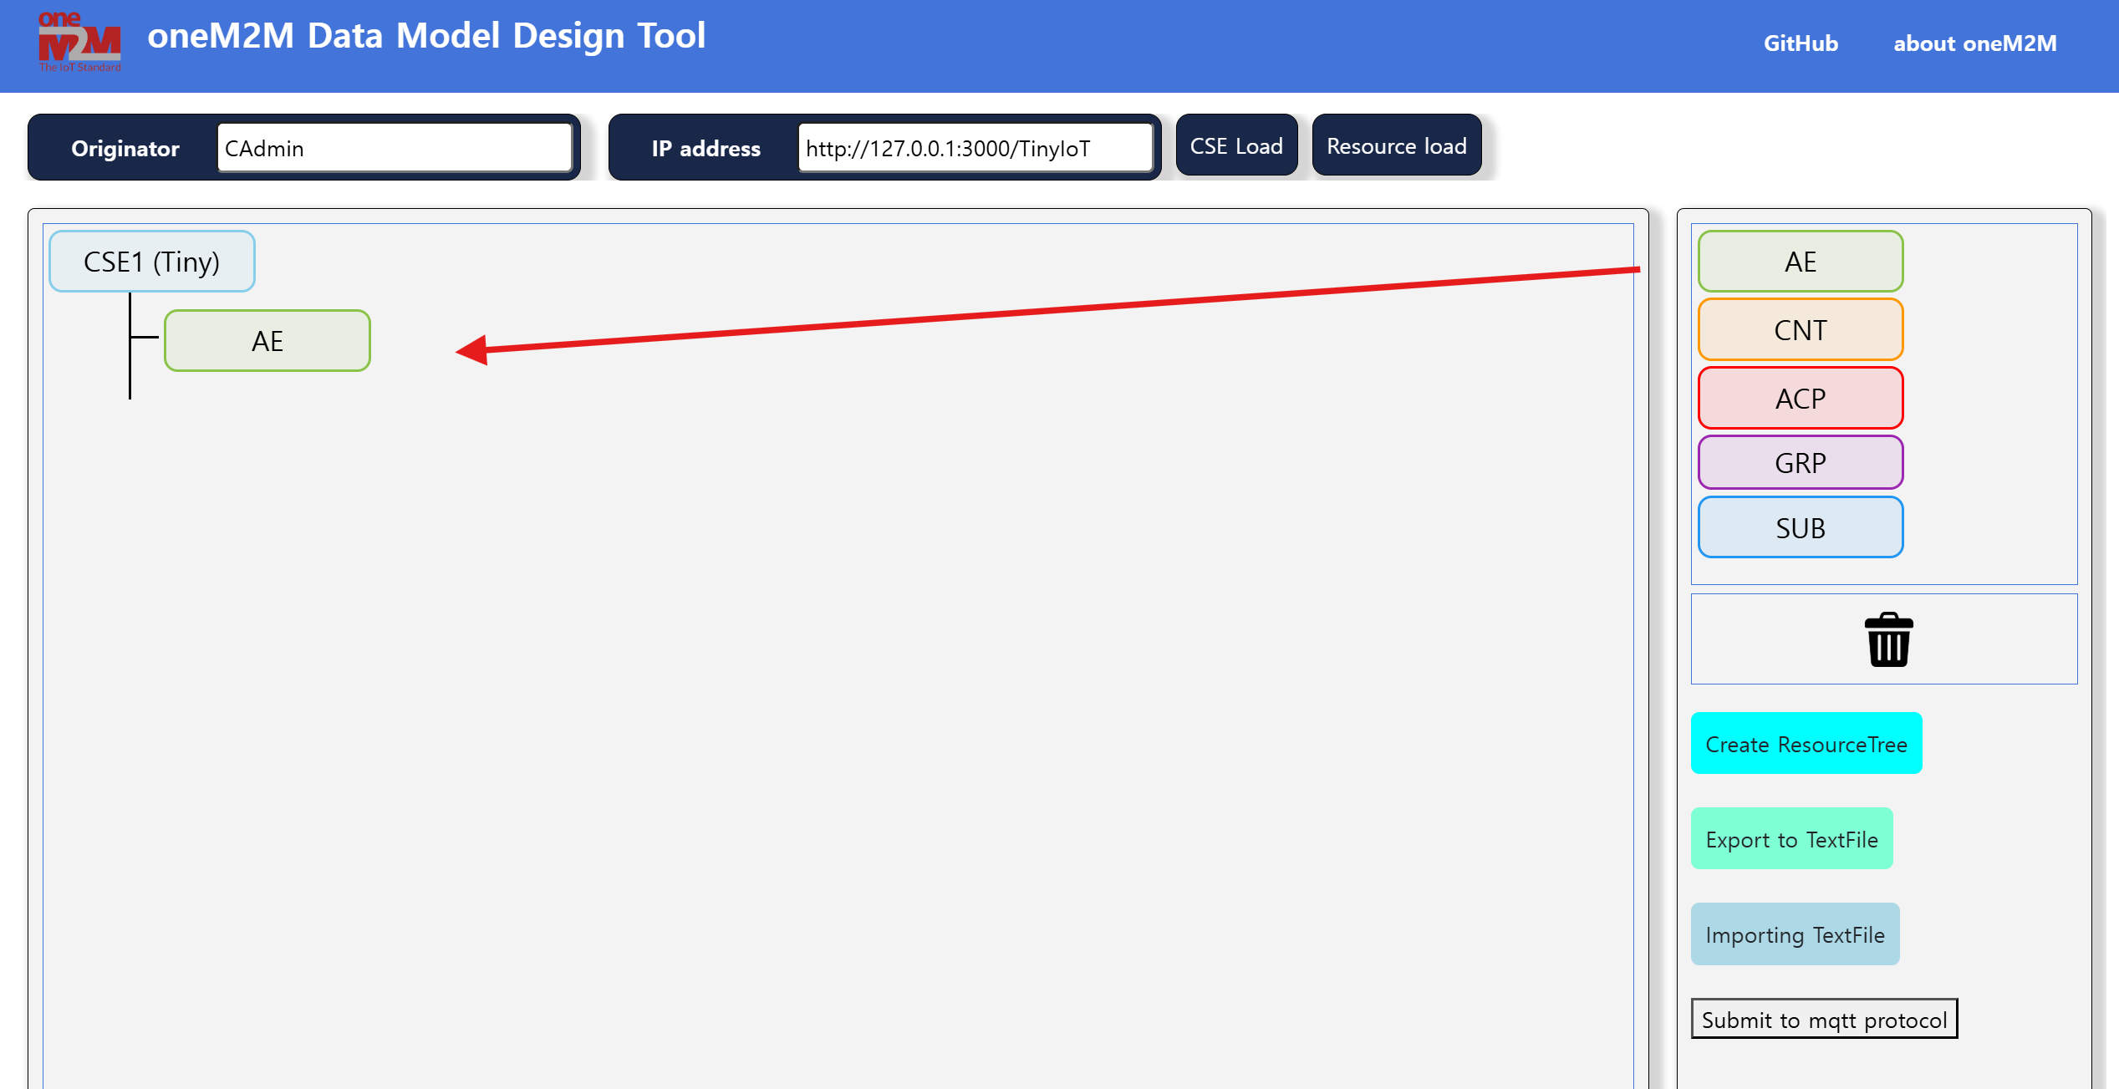
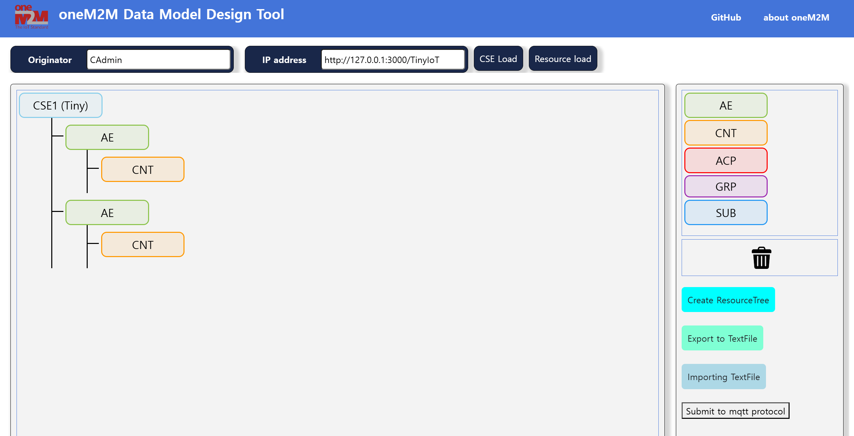
Drag & Drop
Click
Drag & drop
Resource tree created

Slide 15
Create Resources
This feature allows users to create oneM2M-compliant resources using the modeling tool and then deploy them directly to the connected CSE server. You can configure resource attributes and send them to the CSE for immediate use.
How to use
Use Drag & Drop to design your resource structure.
Open the modal for each resource to configure its attributes.
Click the Create Resource button to deploy the resource tree to the CSE.
Verify the resources are created successfully on the CSE server.

Slide 16
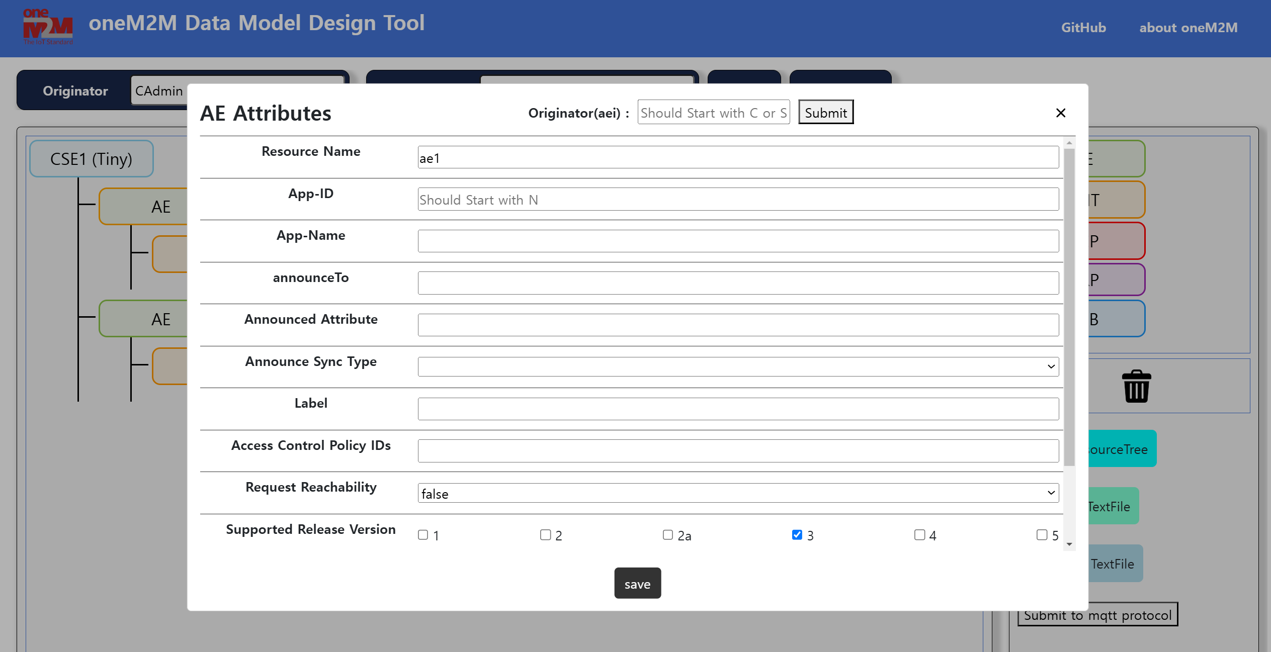
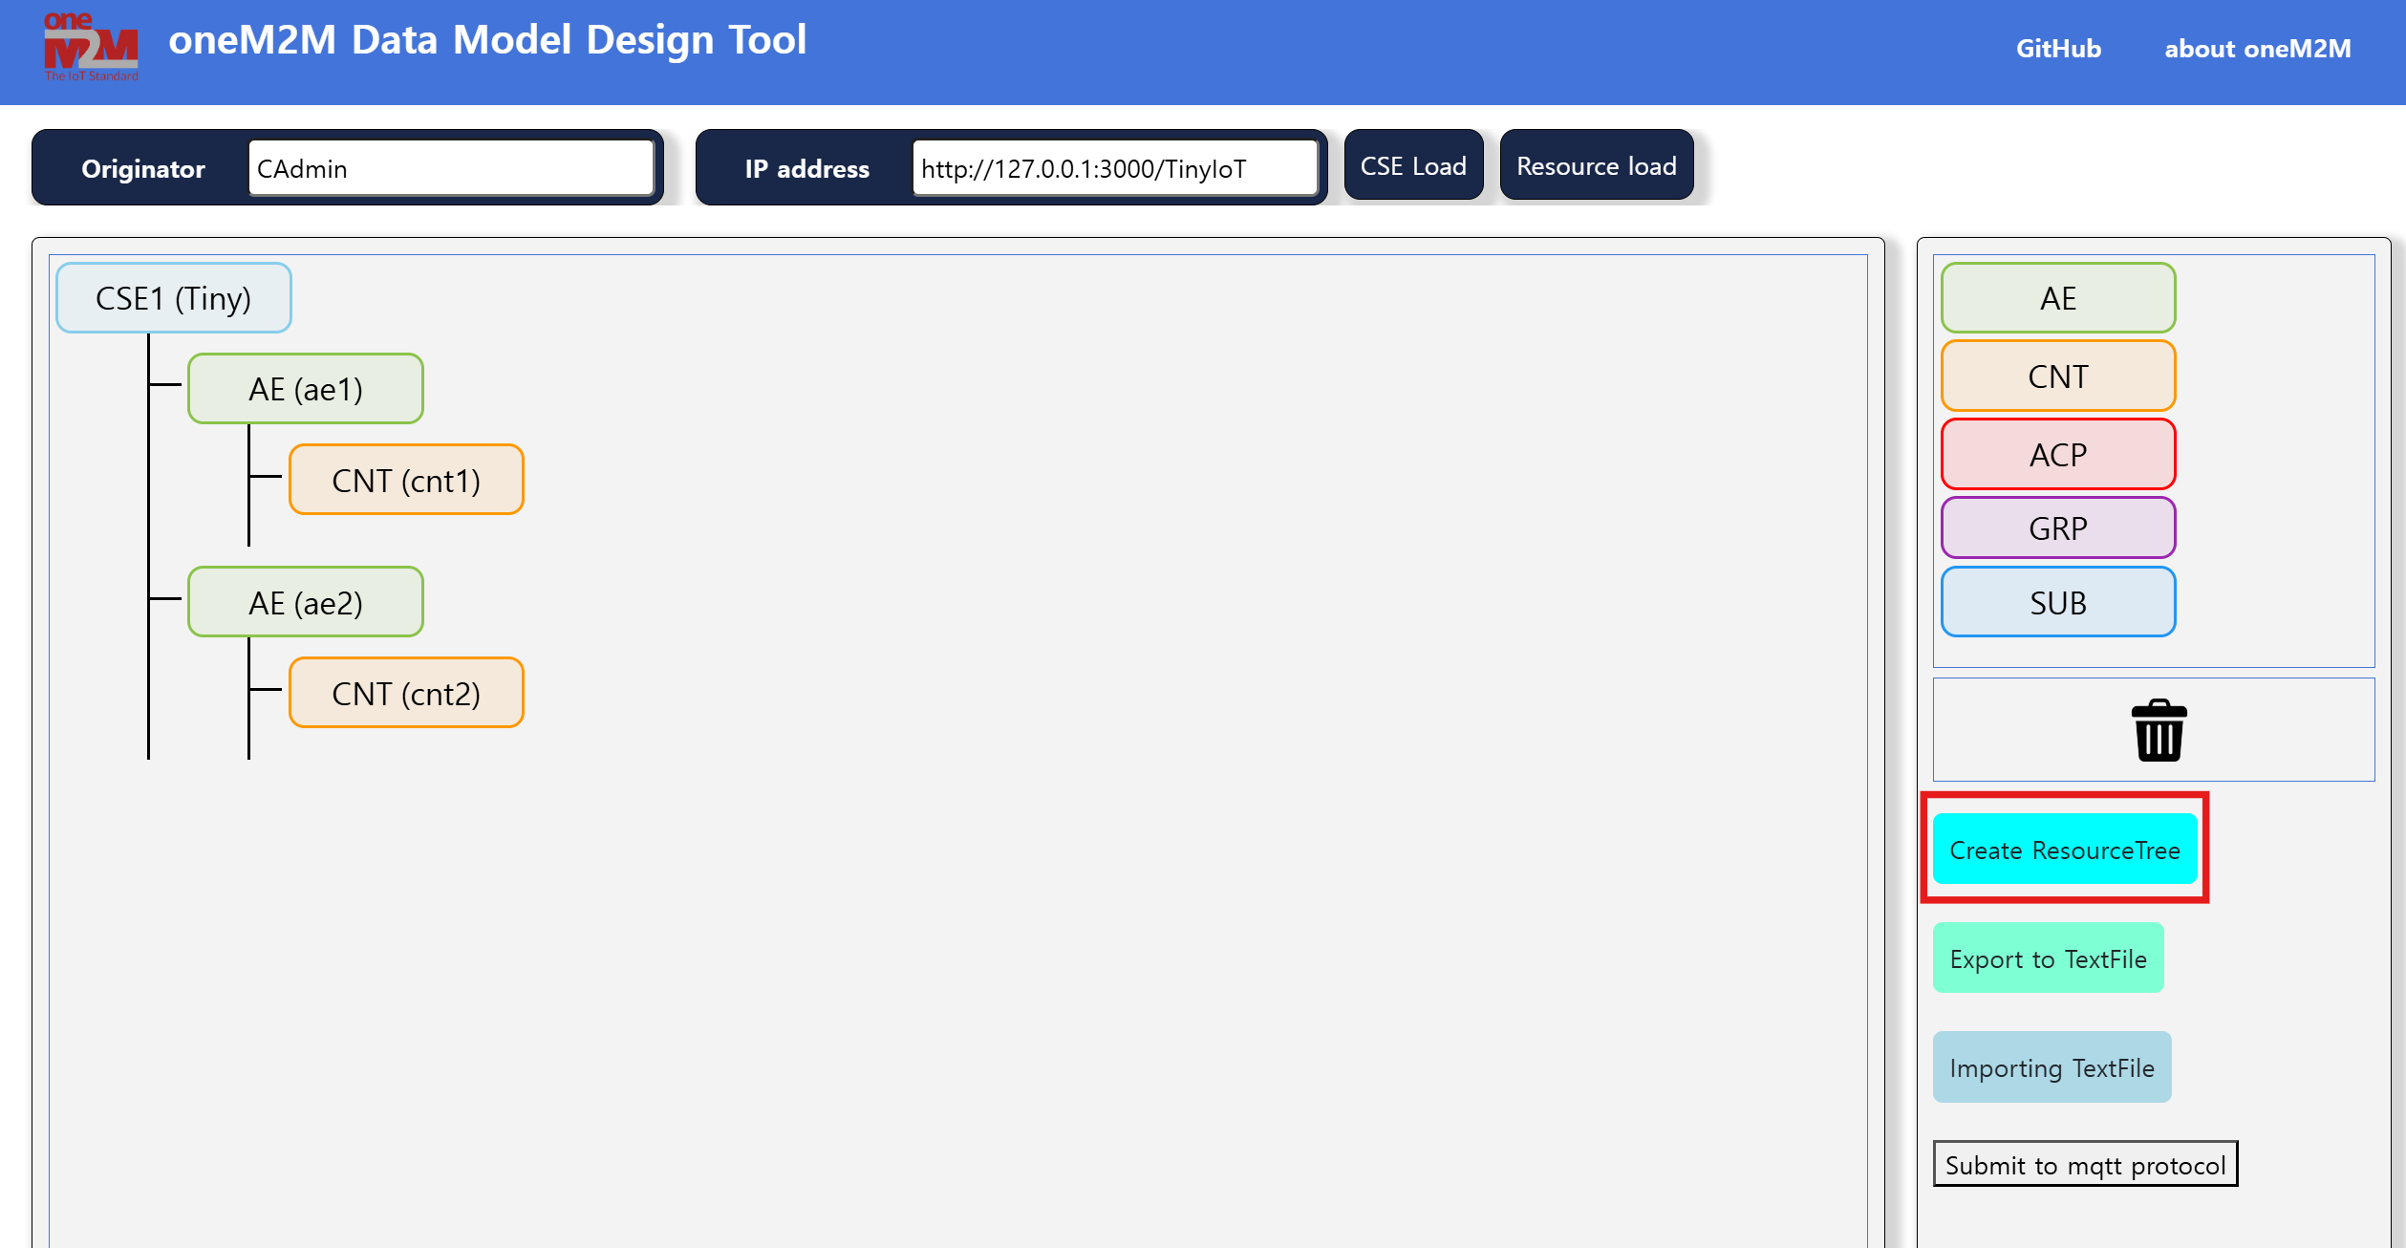
Create Resources

Slide 17
Resource Load
Resource Load lets you load pre-existing resource structures into the modeling tool. This feature supports importing from local files, allowing users to continue working on previously saved models.
How to use
Enter the target CSE server's URL or IP address (if not already connected).
Click the Resource Load button in the toolbar.
Import the resources into the modeling tool.
Modify or extend the loaded resources as needed.

